Slide 1

ABC Call Volume Trend Analysis

Slide 2
Description
A Customer Experience (CX) team plays a crucial role in a company. They analyze customer feedback and data, derive insights from it, and share these insights with the rest of the organization. This team is responsible for a wide range of tasks, including managing customer experience programs, handling internal communications, mapping customer journeys, and managing customer data, among others. In the current era, several AI-powered tools are being used to enhance customer experience. These include Interactive Voice Response (IVR), Robotic Process Automation (RPA), Predictive Analytics, and Intelligent Routing.
Tools used:excel

Slide 3
Hyperlink
Excel :https://docs.google.com/spreadsheets/d/1s-L2-dCUlZKdcEzMK2dWtd5cFVr_oeZY/edit?usp=sharing&ouid=109330305611183196317&rtpof=true&sd=true

Slide 4
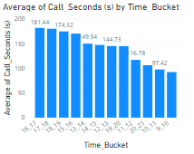
Average Call Duration

Slide 5
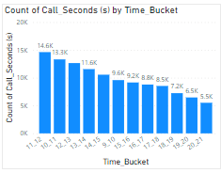
Call Volume Analysis

Slide 6
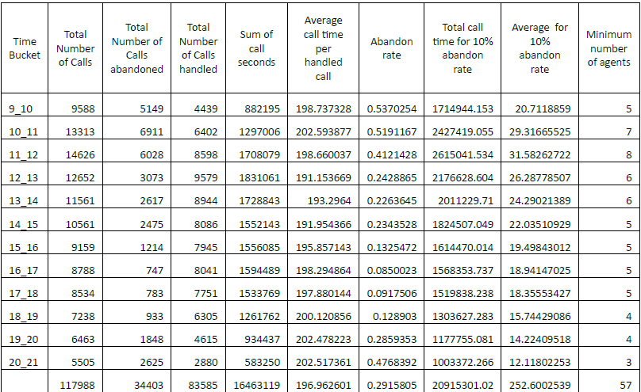
Man power day shift

Slide 7
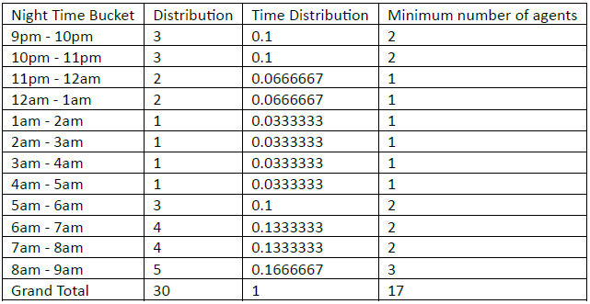
Man power night shift

